Slide 1
Hand Gesture Game Controller

Slide 2
Prepared by
Md Aziz Mia
1521739042
Sakif Ahmmed
16103210142
Md Tanvir Hassan Bhuiyan
1610930042
Md. Siam
1612544042

Slide 3
Objectives
The principle behind this project is very simple. We can control the cars of racing games by this hand gesture device by using the movements of our bare hands. We don’t have to use keyboard or mouse. By this hand gesture device we don’t have to be pushing a button all the time. This device makes the racing games easier to play & very easy to control.

Slide 4
How it works?
In this section we have tried to explain how the sensor will work. We are just using Arduino keyboard library to convert the inputs from IR obstacle sensor to key strokes for controlling the car in racing games.
1. If the top right and top left sensors are trigged then it will simulate up arrow key.
2. If the down right and down left sensors are trigged then it will simulate down arrow key.
3. If the top right and down right sensors are trigged then it will simulate right arrow key.
4. If the down left and top left sensors are trigged then it will simulate left arrow key.

Slide 5
Equipment
Arduino Leonardo
FC-51 IR Obstacle Avoidance sensor
Arduino USB connector
Jumper Wires (M to M & M to F)

Slide 6
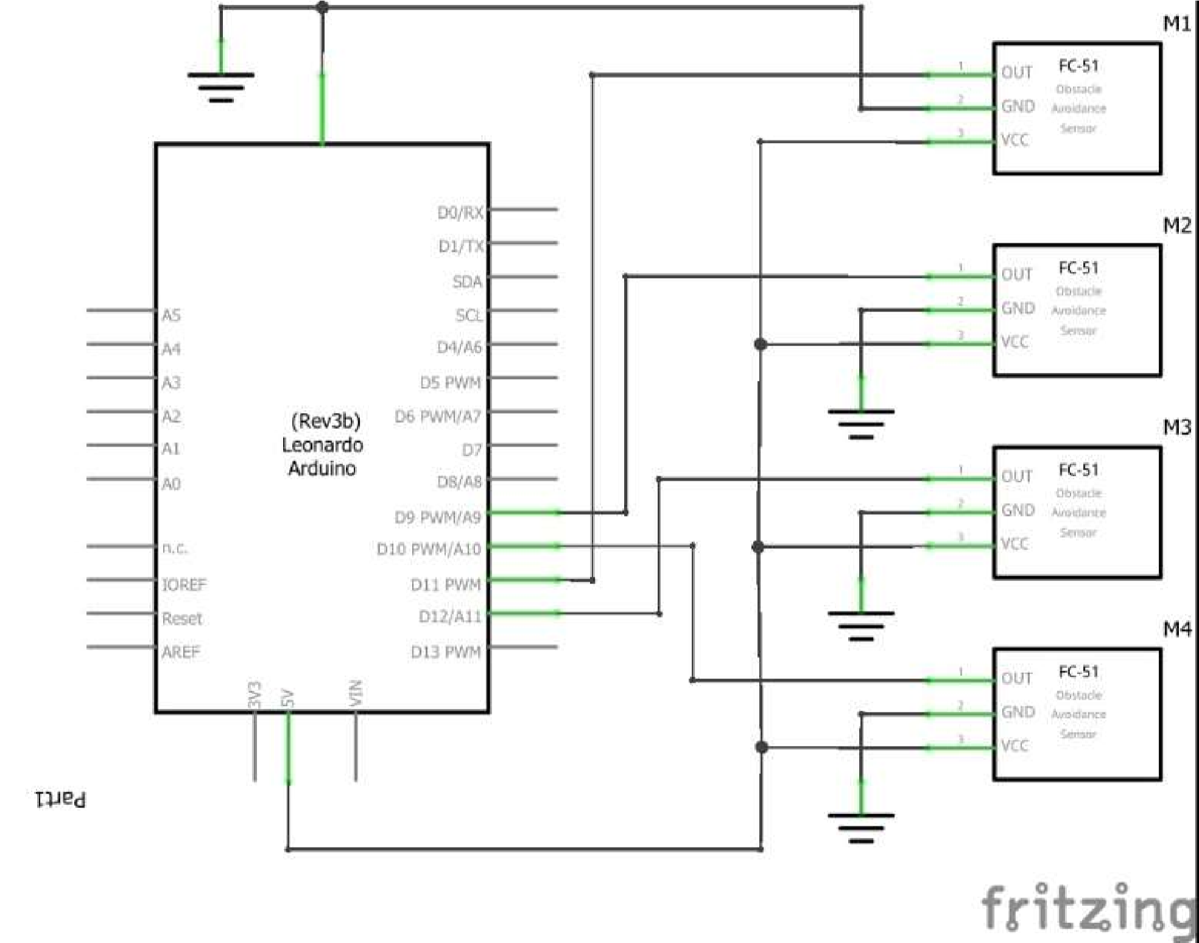
Schematic Diagram

Slide 7
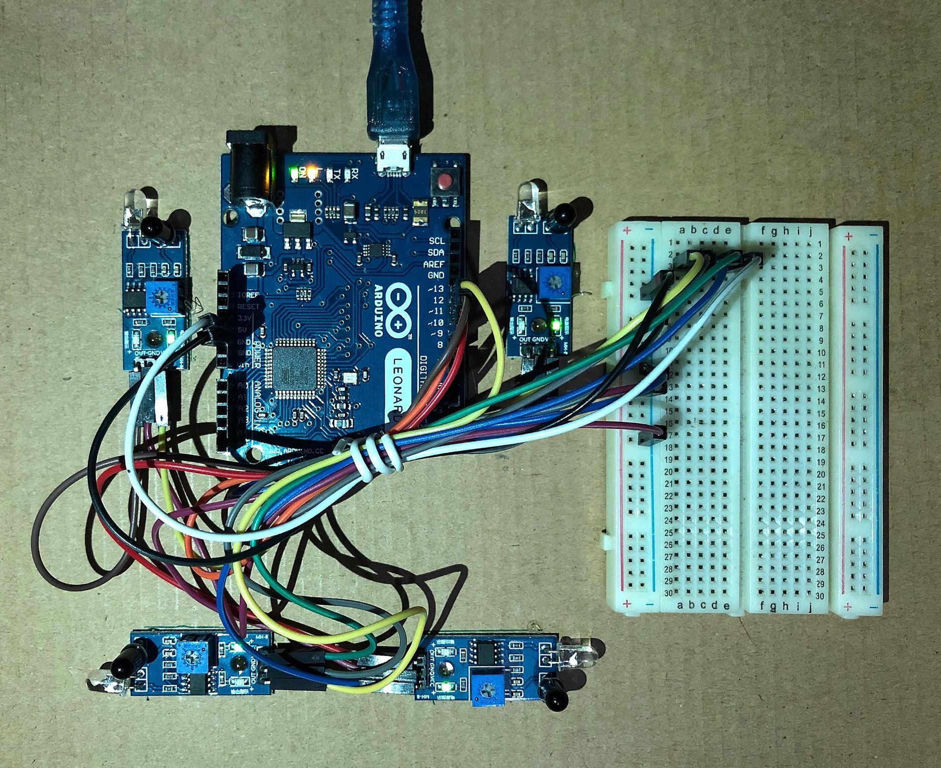
Hardware Overview

Slide 8

ANY QUESTIONS ?

Slide 9


